Slide 1
Enterprise Software Life-cycle Support System
Enterprise TFS - Software Factory NTI
Mike O’Brien, Toby Hable
August 2014

Slide 2
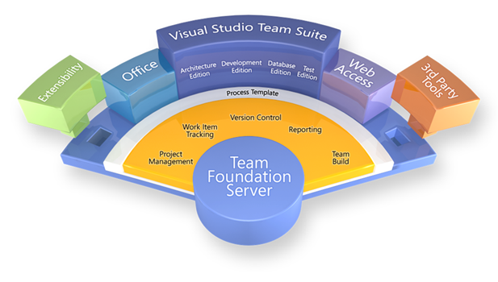
NTI-Core: Software Life-cycle Support System
Technology:
Establish a Software Life-cycle Support System (SLSS) by leveraging Microsoft Team Foundation Server (TFS).
Objectives:
Create Training material
Develop solutions for customer interaction with system
Deploy QA & PROD instances
Initiate migration of HISD Team Projects Complete migration of all HISD Teams
Businesses – HISD, TSSD, IPD
Status: NTI – Core Initiation into Pre-NTI
Resources:
1.25 FTE for
Mike O’Brien 1.0 FTE
Don Carlson 0.50 FTE
Dave Schaller – HISD
Scott Howard – HISD
Total funding request $200 K
Key SEMS Contact: Mike O’Brien

Slide 3
Project Deliverables – Pre-NTI
Status of Deliverables:
System Requirements
Definition of the Service
Draft of ‘Cost of Service’
Engaged additional candidate Divisions
System Architecture
Draft of Service Level Agreement (SLA)
CTOC Presentation

Slide 4
Timeline
 | Aug | Sep | Oct | Nov | Dec | Jan | Feb | Mar | Apr | May | Jun | July
Cost
Install QA/PROD
Ops Team Training
Build Team Queue
Initiate HIS Team Onboarding
Onboard existing semstfs teams

Slide 5
Cost of Service
Flat fee for each user of $10/user per month
Charge for:
Team On Boarding
Customization or system extension
Training – TFS and Process Methodology
Process Guidance services
System Extension

Slide 6
Budget and Timeline
DevOps team
install & setup
Build training curriculum
Chargeback spin up as teams on boarded
Chargeback for onboarding

Slide 7
Setup Investment
Startup cost – bring in Microsoft Consulting for implementation and consultation of entire service: $200k

Slide 8
Technology Platform and Roadmap
Requirements
Authoring Requirements document with Enterprise defined structure, methodology, and process
Cloud Hybridization
Cross Platform Builds
(iOS / Xamarian / Android / Linux)
Rollup Reporting
(self-service reporting portal)
Value Added
DevOps
Automated build, deploy and testing harnesses
Enterprise Software Development Process
Process Template
Project Management
Requirements Management
Version Control
Test Case Management
Build Automation
Reporting
TFS Technology
Platform
TFS

Slide 9
On Boarding
Bringing new teams onto ETFS will take time, and investment

